Slide 1
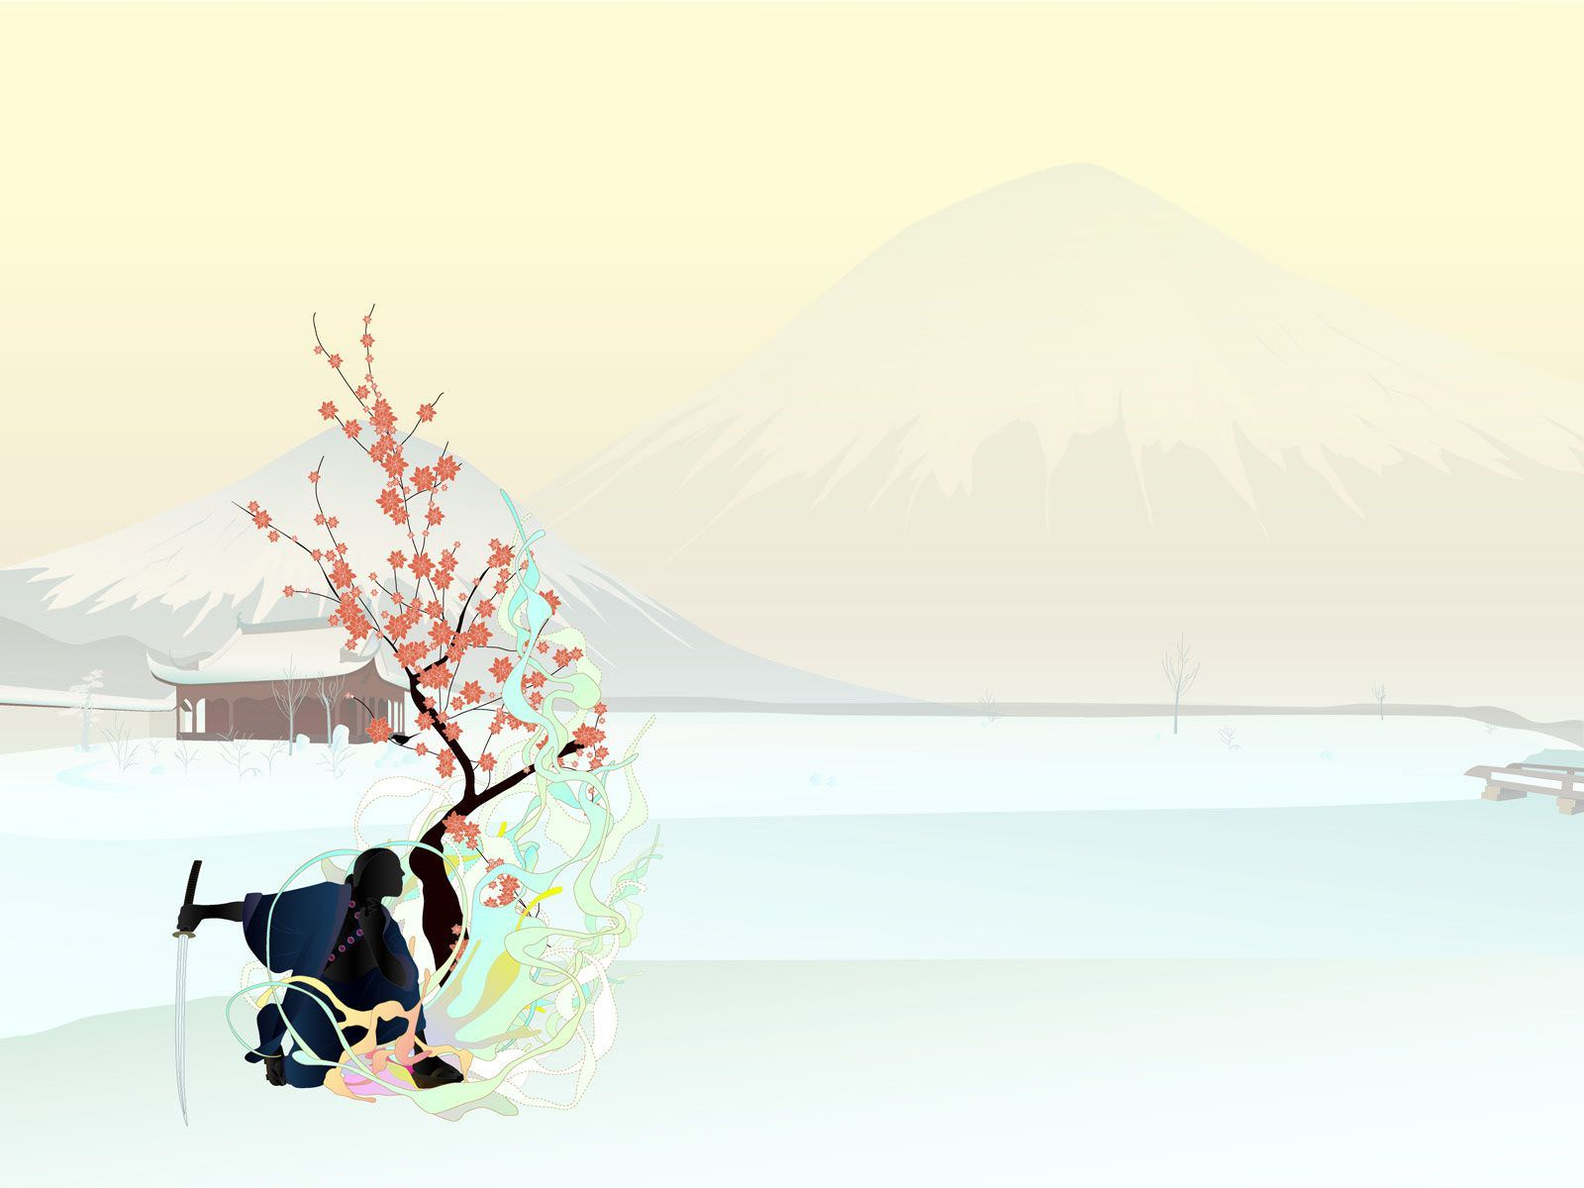

ENGLISH ASSIGNMENT 1.1
TOPIC: A Cultural Event
HANAMI FESTIVAL
Teacher : | NguyenNH
Student : | Nguyen Quoc Tuan
SID : | PH08378
Class : | ENT1123.1

Slide 2
OUTLINE
I. INTRODUCTION
Overviews of Hanami
II. BODY
1. All of Hanami Festival
2. Traditional Food - Cultural Activities during Hanami Festival
3. My Experience and Feelings with Hanami
III. CONCLUSION

Slide 3
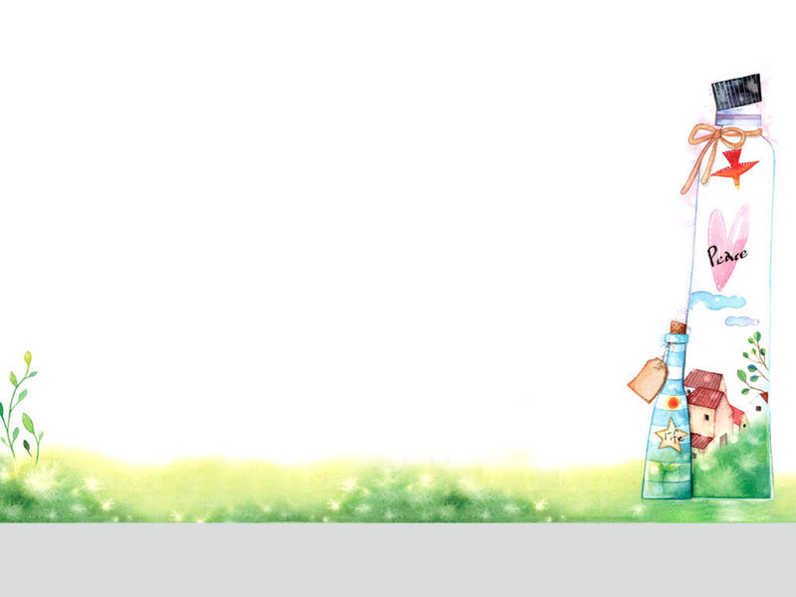
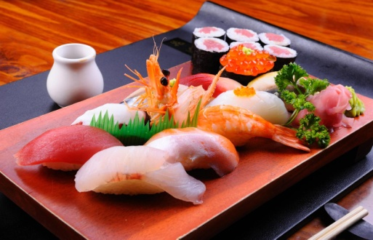
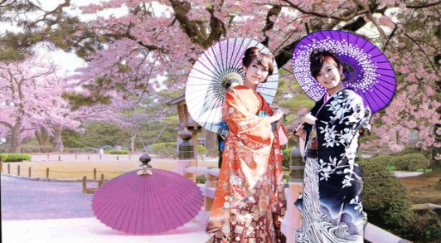
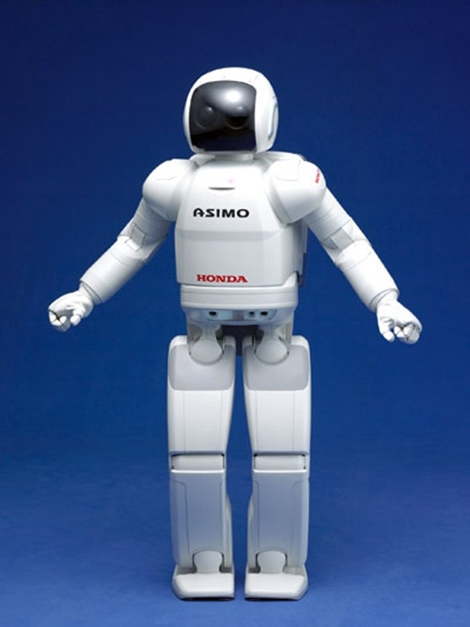
I.INTRODUCTION
Traditional Food
JAPAN
Traditional Clothes
Technology

Slide 4
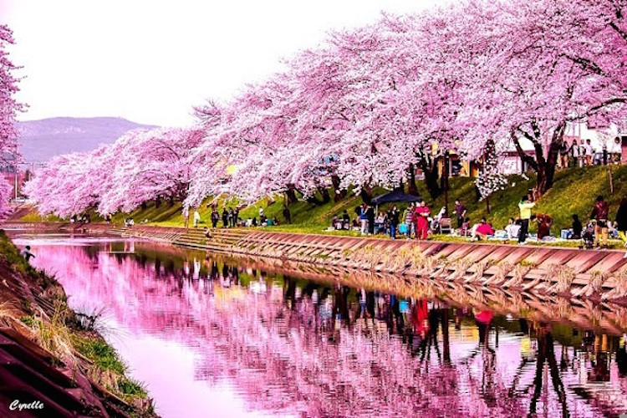
Cultural Event
Hanami Festival

Slide 5
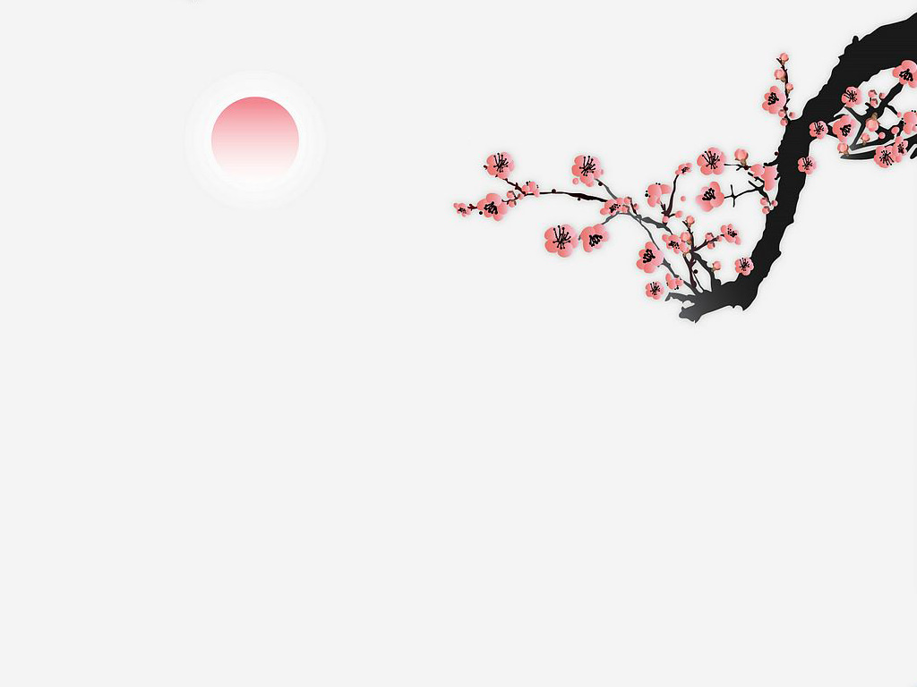
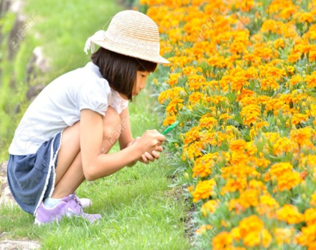
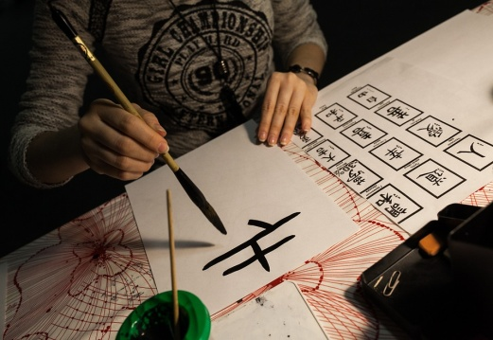
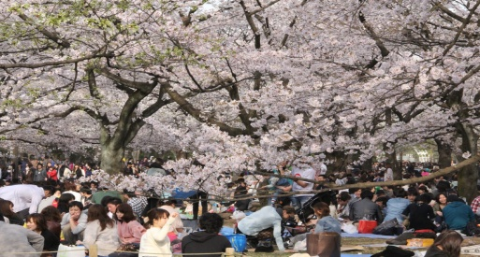
II. Body
1.All of Hanami Festival
The Meaning
Hanami
Concept
Origin
Today

Slide 6
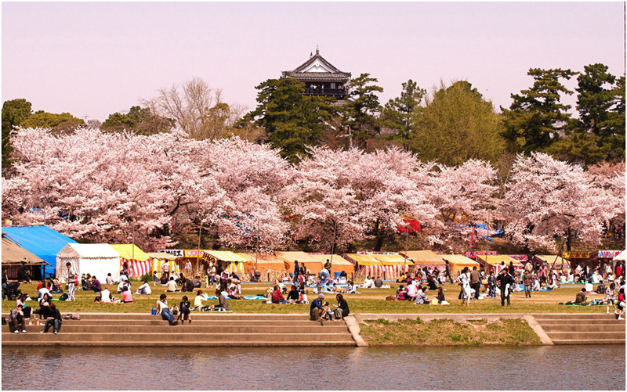
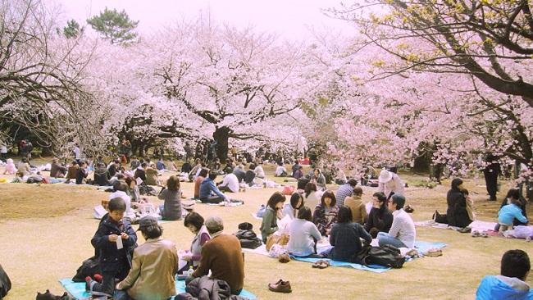
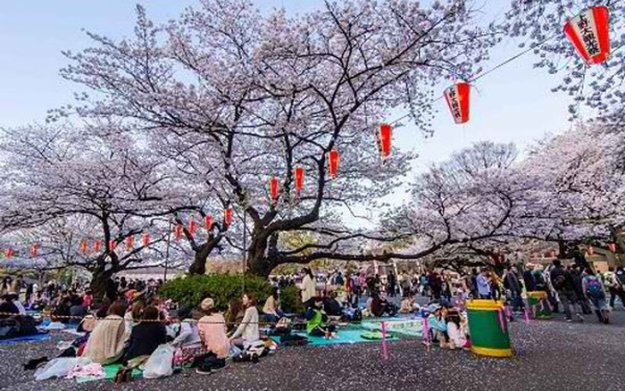
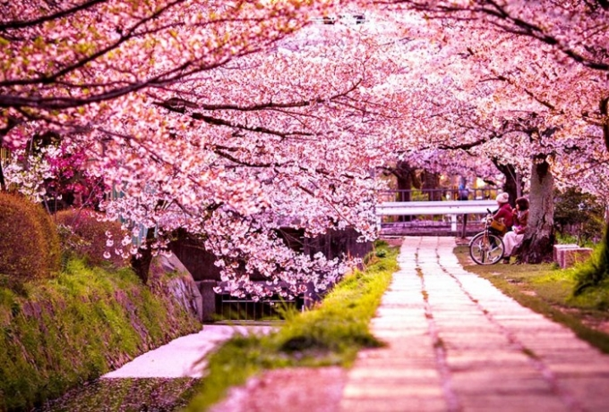

Slide 7

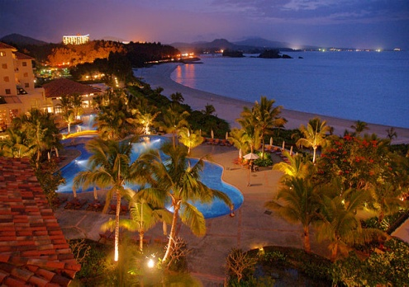
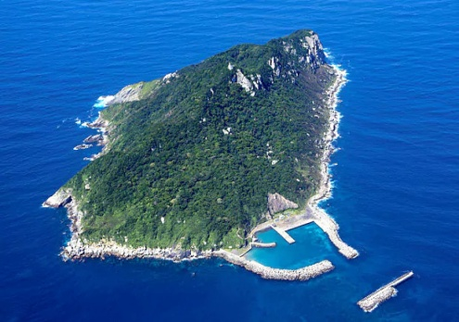
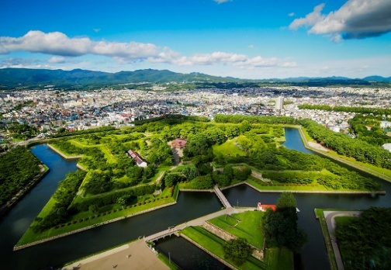
TIME
HANAMI
FESTIVAL
January
OKINAWA
March
HONSHU
April
May
HOKKAIDO

Slide 8

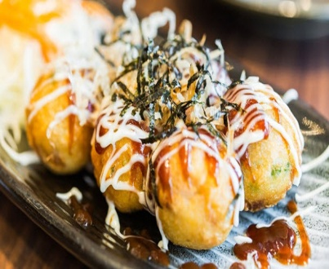
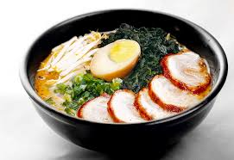
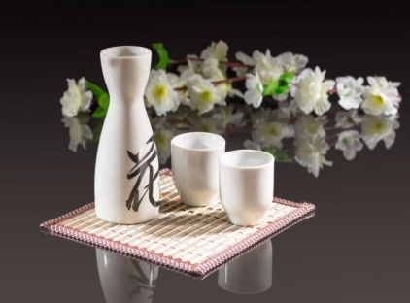
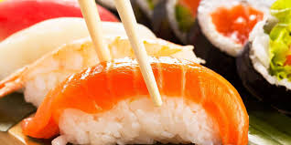
2. TRADITIONAL FOOD-CULTURAL ACTIVITIES DURING HANAMI FESTIVAL
TRADITIONAL
FOODS-DRINKS

Slide 9
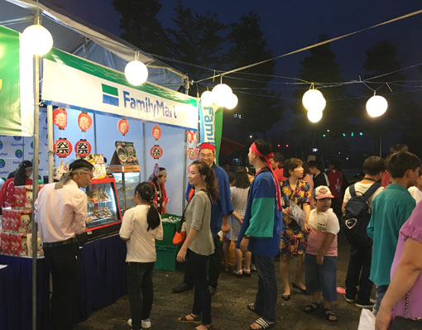
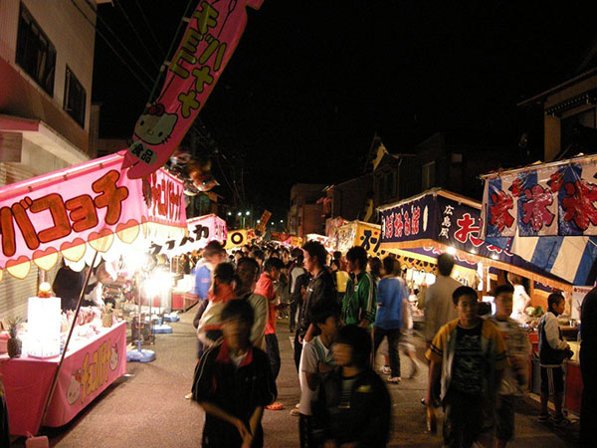
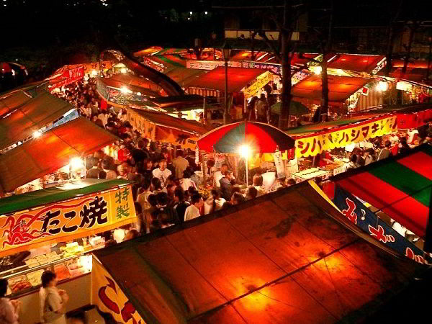
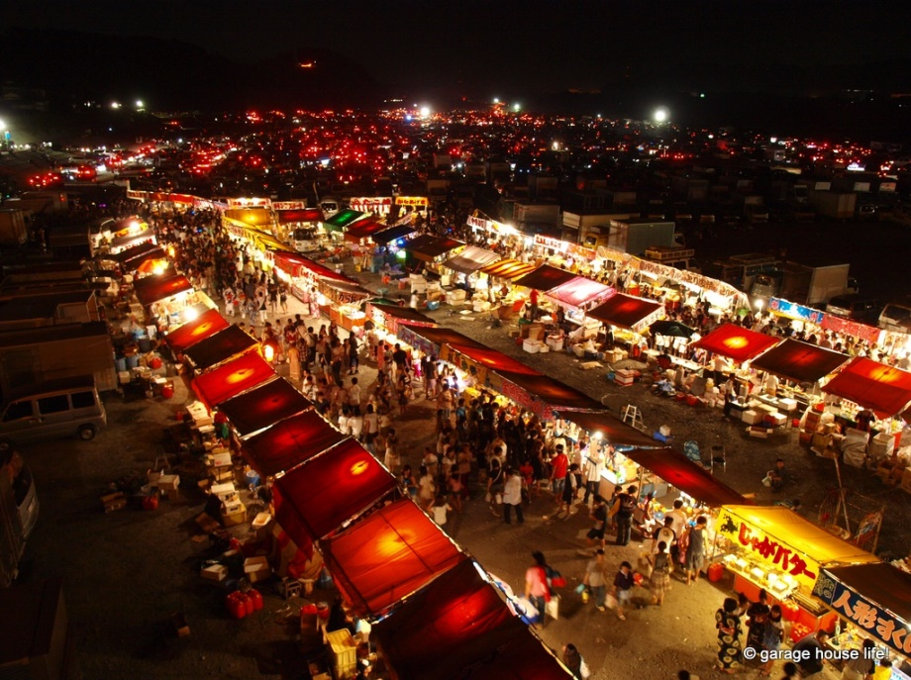

Slide 10
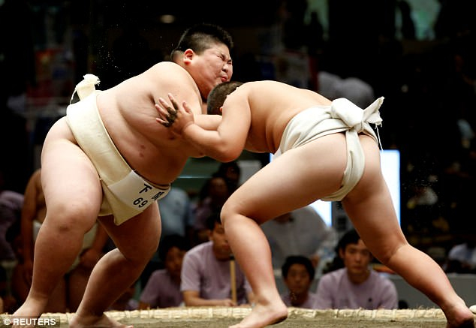
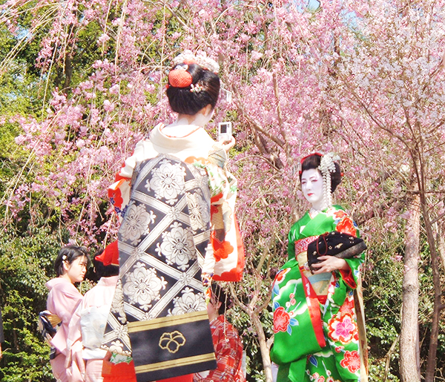
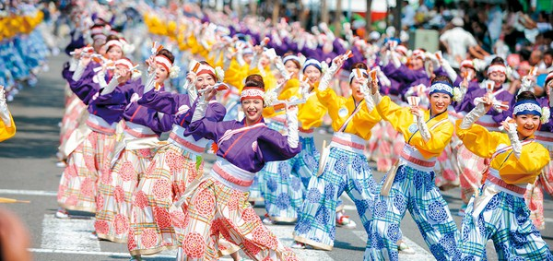
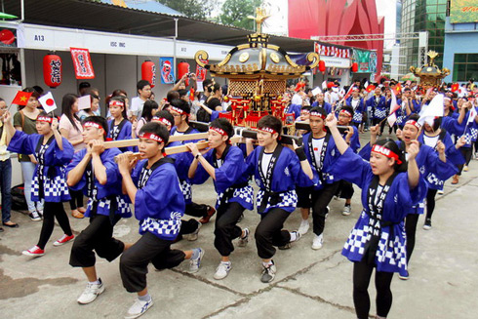
Japanese Cultural Activities
SUMO FIGHT
KIMONO
Sumo Boxers
TRADITIONAL DANCES
PROCESSION

Slide 11
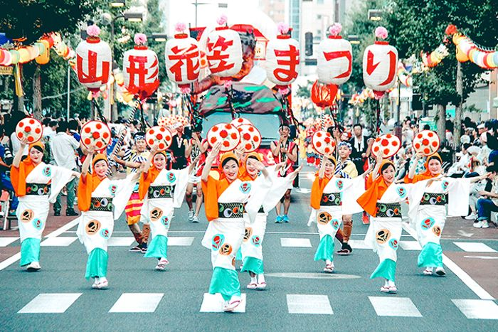
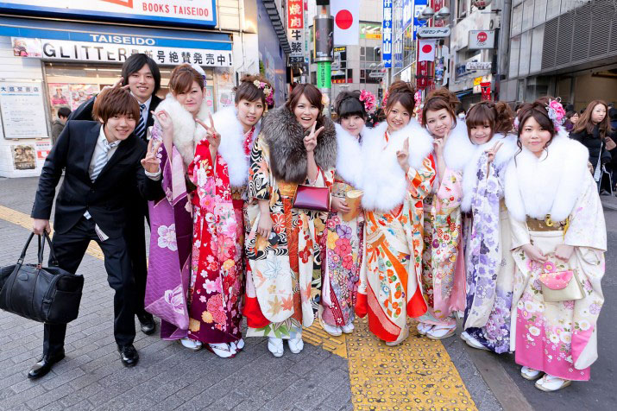
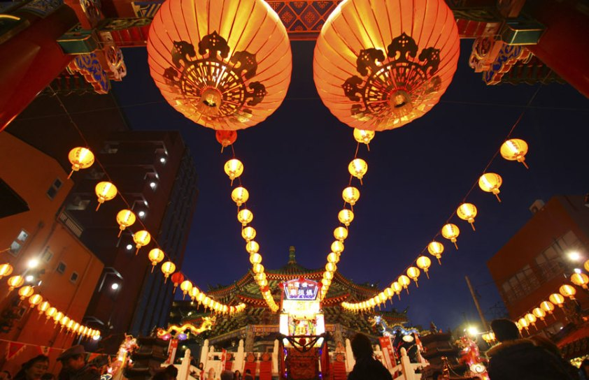
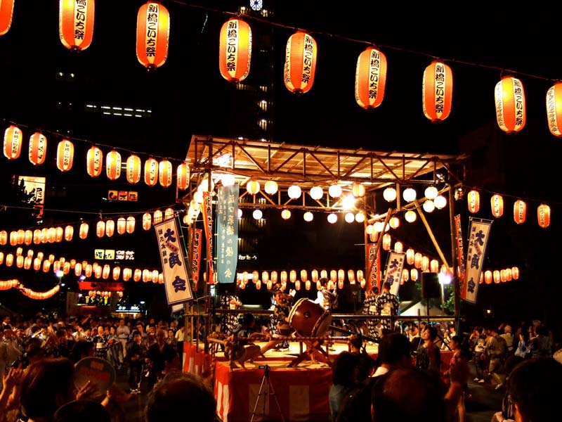
3.MY EXPERIENCES WITH HANAMI FESTIVAL

Slide 12
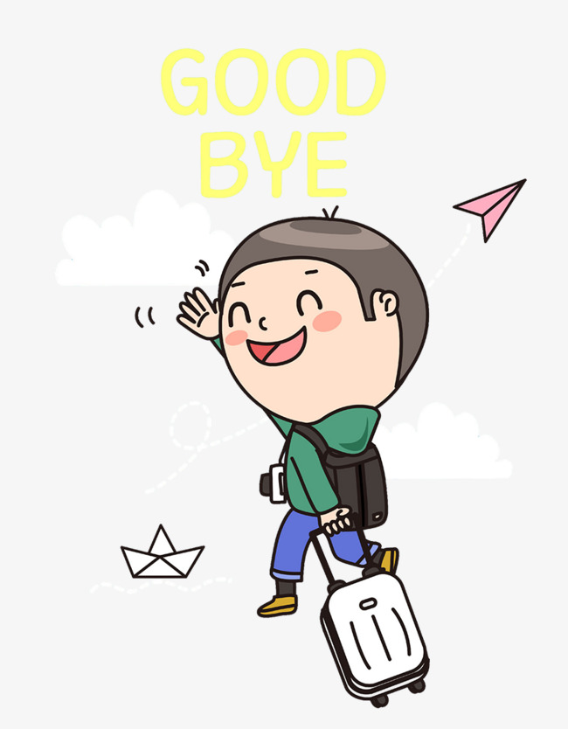
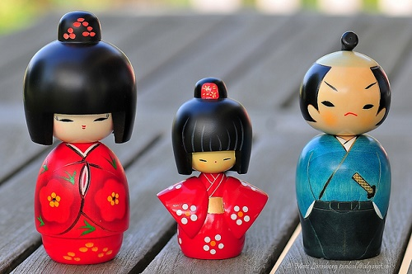
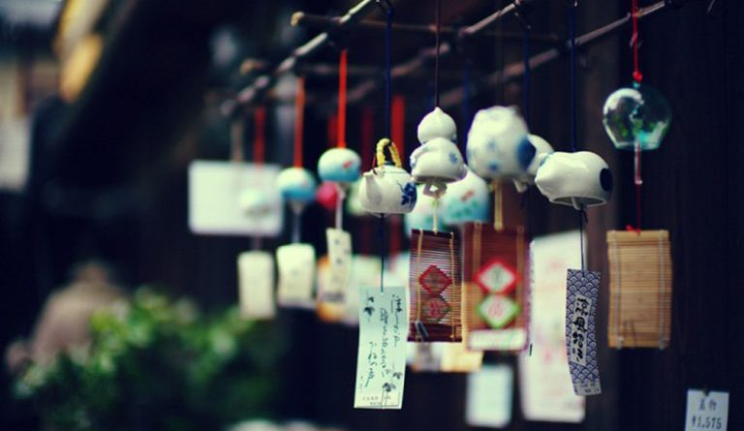
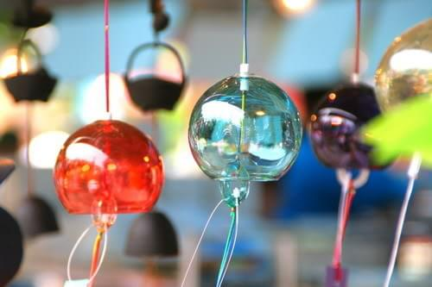
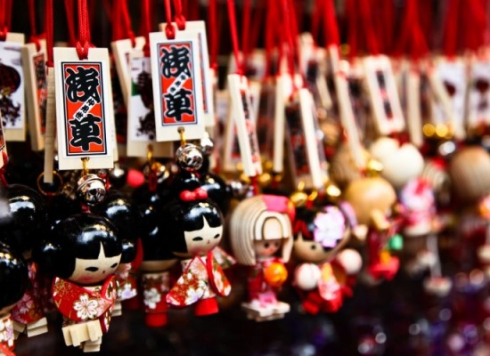
SOUVENIR

Slide 13
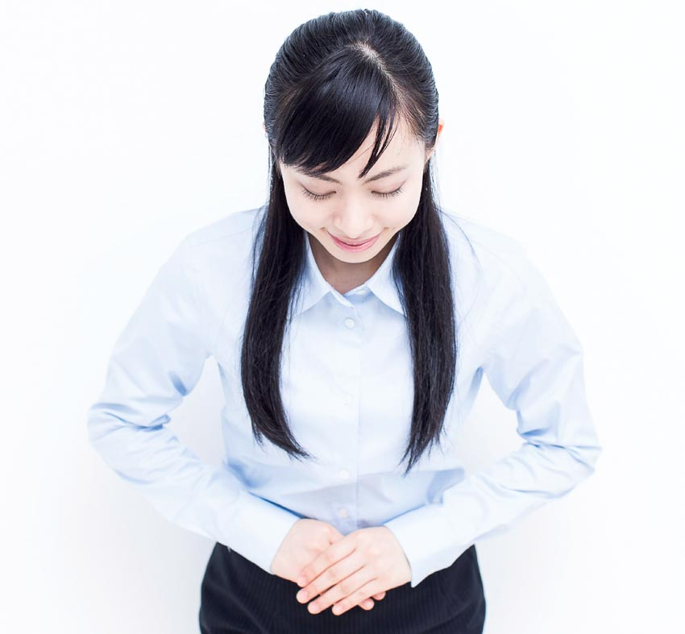
Do not expect to see the flowers wherever you go, cherry blossom blooming at different times throughout Japan will create its own beauty.

Slide 14
